Slide 1

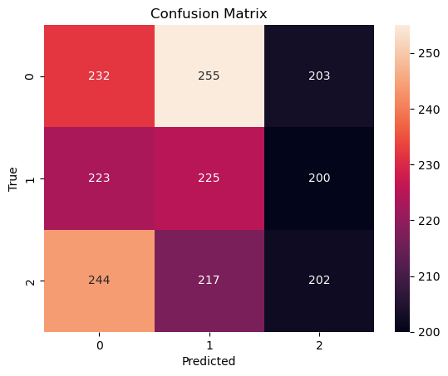
AI-Driven Guest Profiling For Hotel Management (United States/New Jersey)
Mithun Dama
Pace University, Seidenberg School of CSIS
GitHub: https://github.com/mithundama1997/CapstoneProject-Dataset
Abstract: Hotel Industries Continually Seeks Innovative Methods to improve their services to serve the guest better. This Study Uses Artificial Intelligence to enhance guest profiling by analyzing a dummy dataset with features related to guest. Here, using a Random Forest Classifier, a multi-class classification algorithm, the project aims to predict guest behavior scores. The Outcome of this study shows that Implementing AI in guest profiling can have a major influence on hotel operations, resulting in improved guest experiences, and a reduction in customer-related incidents.
As [5,6] Investigates facial recognition technology & Predicts hotel booking cancellations using machine learning algorithms in smart hotels.
Model performance was iteratively improved through hyperparameter tuning and feature engineering.
Results of the Random Forest Classifier model evaluated using Confusion Matrix.
Conclusion & Future Work:
While Random Forest Classifier demonstrates promising results with Dummy Data to get model accuracy of 62% compared to Gradient Boosting with model accuracy of 56%. This Findings suggest that AI-driven guest profiling can significantly enhance hotel management with real time data. Future work includes expanding the dataset, incorporating additional features, and exploring advance deep learning approaches for more nuanced behavioral predictions and expanding the dataset to include online behavior and social media interactions.
Dataset: The Dataset Used for this study was generated as dummy dataset for 10,000 guest profiles from five different hotels in New Jersey, with 11 different features encompassing features such as length of stay, hotel services used, feedback scores, and behavioral indicators. And the target Variable is Guest Behavior Score which is a multi-class categorical value. The dataset was engineered to avoid data leakage and ensure realistic representation of the hotel environment.
Results: The Random Forest Classifier Performed the Satisfactory for the Dummy Dataset which we generated for this project based on real time features. Got 51% Model Accuracy using Random Forest Classifier when compared to Gradient Boosting for Dummy Data set. But When We tried the same model for Real time data the Accuracy of model increases more than the dummy dataset. The results of the Random Forest Classifier model were evaluated using a confusion matrix.
Research Question: How can a machine learning and AI-driven analytics can be utilized to profile guest behavior and optimize the hotel management strategies for hotels located in United States?
Methodology:
Sampled 10% of original Dataset.
Cleaning, encoding, and normalizing data to prepare for modeling.
The dataset was preprocessed to encode categorical variables and normalize numerical values.
Feature Engineering & Standardization was performed on the model.
Based on the Categorical Target Feature adopted a multi-class classification approach using Random Forest Classifier, Support Vector Machine & Gradient Boosting algorithms.
References:
[1] Deshpande. 2022. An AI Integrated Online Hotel Management System. Journal of Web Engineering & Technology, Volume 9, Issue 1. http://computers.stmjournals.com/index.php?journal=JoWET&page=index
[2] Eid Alotaibiy. 2020. Machine Learning in the Hotel Industry. (JAAUTH), Vol. 18 No. 3, (2020). https://jaauth.journals.ekb.eg/
[3] Pongsakorn Limna. 2022. Artificial Intelligence (AI) in the Hospitality Industry: A Review Article. International Journal of Computing Sciences Research. (JAAUTH), Vol. 18 No. 3, (2020). orcid.org/0000-0002-7448-5261
[4] Takayuki Suzuki, Kiminori Gemba, Atsushi Aoyama. 2023. Hotel Classification Visualization Using Natural Language Processing of User Reviews. Graduate School of Technology Management, Ritsumeikan University, Shiga, Japan.
[5] Zhang-Bin Chen, Yang Liu. 2021. Application of Face Recognition in Smart Hotels. IEEE.
[6] M. Venkata Rakesh. 2022. Hotel Booking Cancellation Prediction using ML algorithms. Department of CSE, Sathyabama Institute of Science and Technology, Chennai. [DOI: 10.1109/ICAIS53314.2022.9742843]
Related Work: Previous studies have shown that AI and machine learning can significantly influence the hospitality industry by predicting guest preferences and optimizing resource allocation. [1,2] Explores AI integration for online hotel management systems & the applications of machine learning in the hotel industry. When it comes to AI service quality [3] it shows the AI impact on service quality in hospitality industry. When it comes to feedback about user reviews [4] Utilizes NLP for hotel classification based on user reviews.
In this confusion matrix, no class seems to be predicted with outstanding accuracy, considering that the numbers of false positives and false negatives are quite high relative to the true positives. This may suggest that the model is somewhat balanced in its ability to recognize the classes but is not highly accurate, as there are many instances where it has confused one class with another.

